Slide 1

Filmscope
Progress Internship Project
Izota Andreea

Slide 2

Agenda
What is Filmscope
User flow
Project architecture
Used tools
Future implementation
Demo
My internship
experience

Slide 3
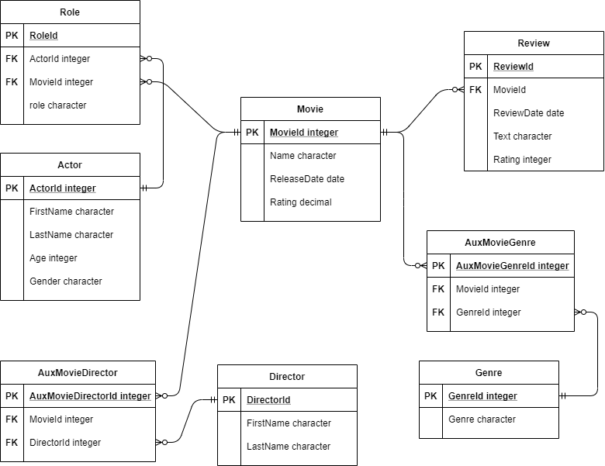

What is Filmscope
A database for movies
Why?

Slide 4





What is Filmscope
The main functionalities of the application are:
A home page to see six of the newest movies, six of the movies with the greatest ratings, all the movies and all the actors
Searching actors by name or by movies they played in
Searching movies by name or by actors who played in the movie
Filter movies by rating and genre
Add reviews to movies

Slide 5
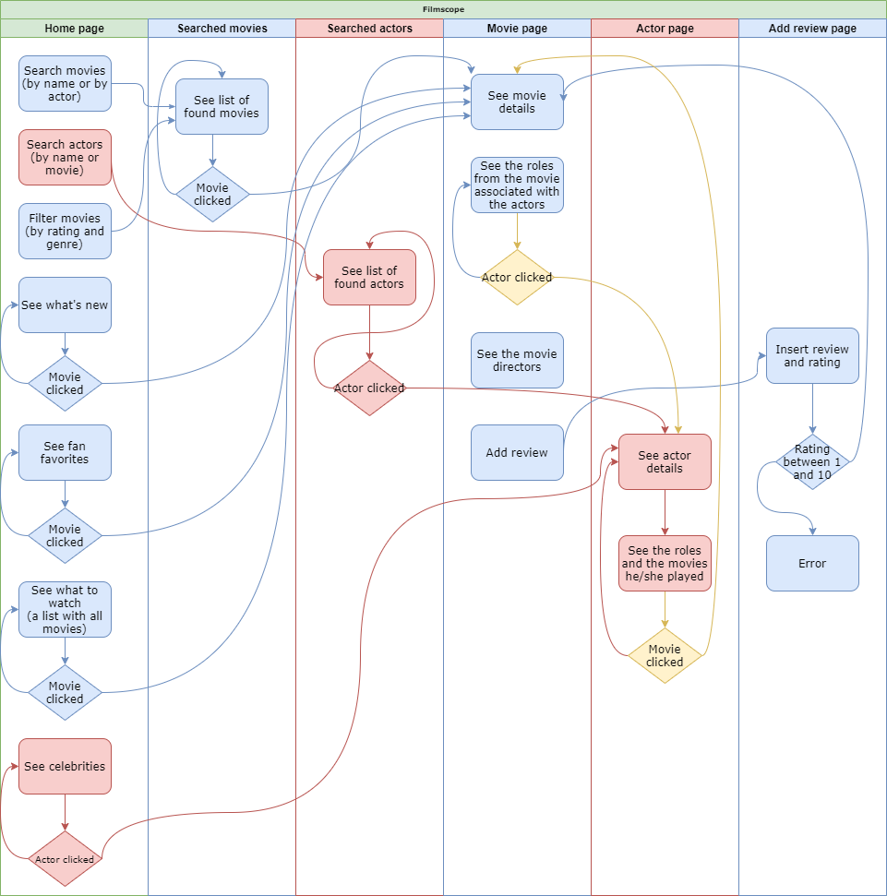
User flow

Slide 6
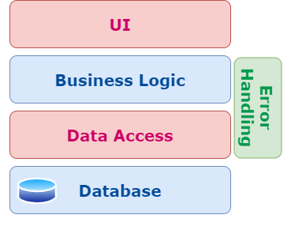
Project architecture
Database – for storing the data
Data Access – manages the retrieval of data
Business Logic – for the application’s logic
Error Handling – personalized
UI – for a better interaction between the user and the application

Slide 7


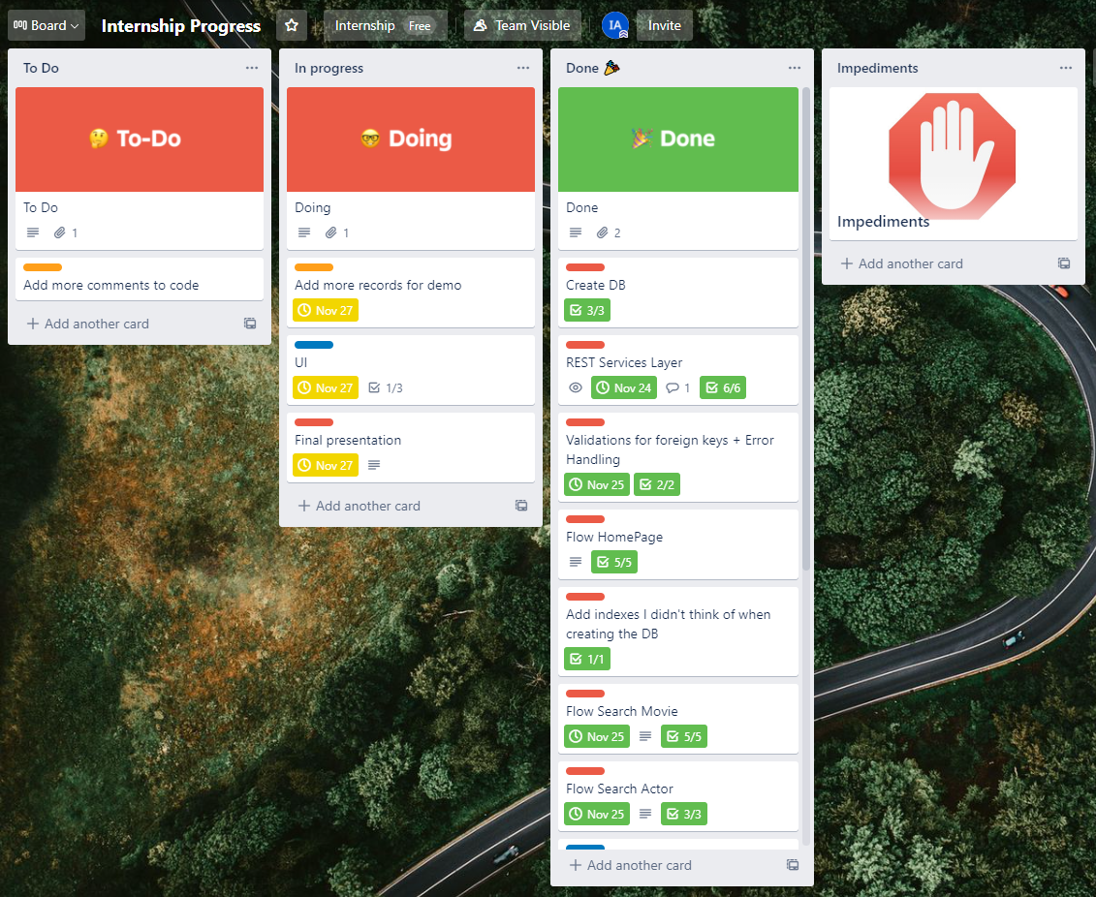
Tools used for organization
Used for managing and prioritizing tasks
Used for versioning the project

Slide 8


Tools used for development and testing
Used for writing code
Used for testing the APIs

Slide 9
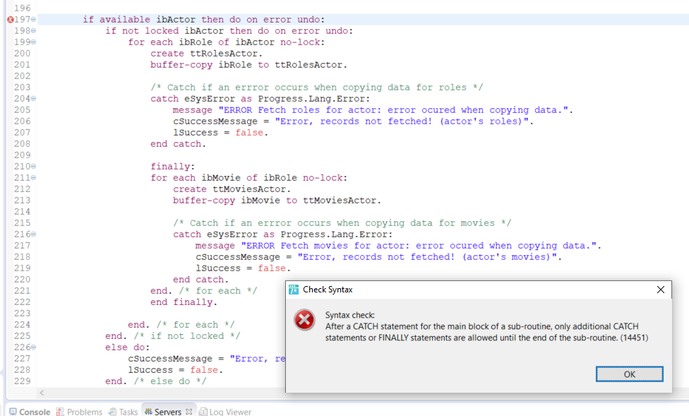
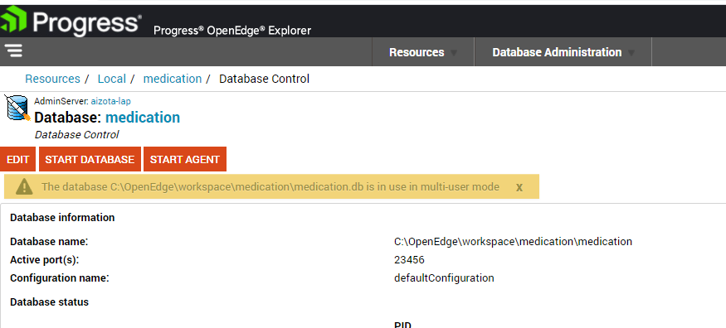
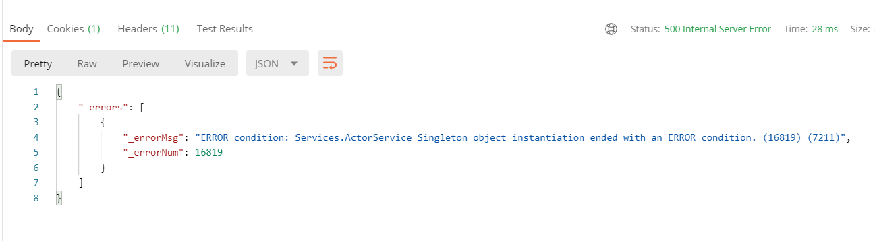
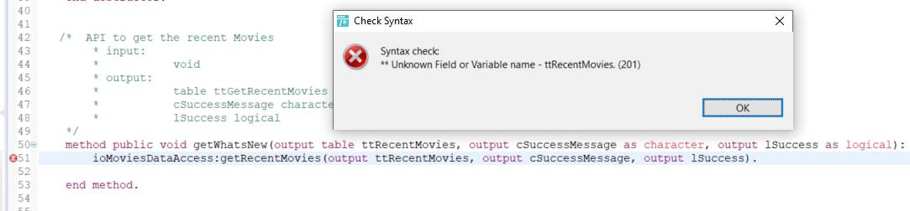
Errors? Of course I had…A lot

Slide 10

My internship experience
I had the opportunity to see an amazing team, from the very beginning
I received answers as soon as possible
I received interesting information from different trainings
I learned the basis of Progress
I deepened my knowledge in databases
I learned to work with Postman
I made my first little project with Progress
I took the challenge and created my first page with html and CSS
I wish I had more time to improve the application
I wish I met my colleagues in real life

Slide 11

Future implementation
Implementation for director to add movies
Implementation for an admin to add, delete and update actors, directors, genres
Photos for actors
Add awards for movies, actors and directors
Finish the UI

Slide 12

Demo
For now, let’s focus on the present

